Slide 1
INTE 22283 – Mobile Application Development
Week 3: Mobile Development Platforms
Sammani Maddumahewage
Lecturer (Probationary)
BSc (Hons) in Information Technology

Slide 2
Today's Learning Outcomes
Differentiate between native, hybrid, and cross-platform development approaches
Evaluate the advantages and limitations of each development approach
Identify popular native development tools (Android Studio, Xcode)
Introduce cross-platform frameworks (Flutter, React Native)
Compare performance, cost, time-to-market, and maintainability across platforms
Apply a decision framework for selecting a platform based on project requirements
Configure a development environment for a chosen platform
Build and run a simple “Hello World” application

Slide 3
Recap and Framing
Last two weeks: We covered mobile networks and mobile operating system architecture — the foundation every app runs on
This week: We address the practical question every project starts with: which development approach should we actually use to build the app?
Why it's not obvious: There is no single “best” approach — the right choice depends on performance needs, budget, timeline, and team skills

Slide 4
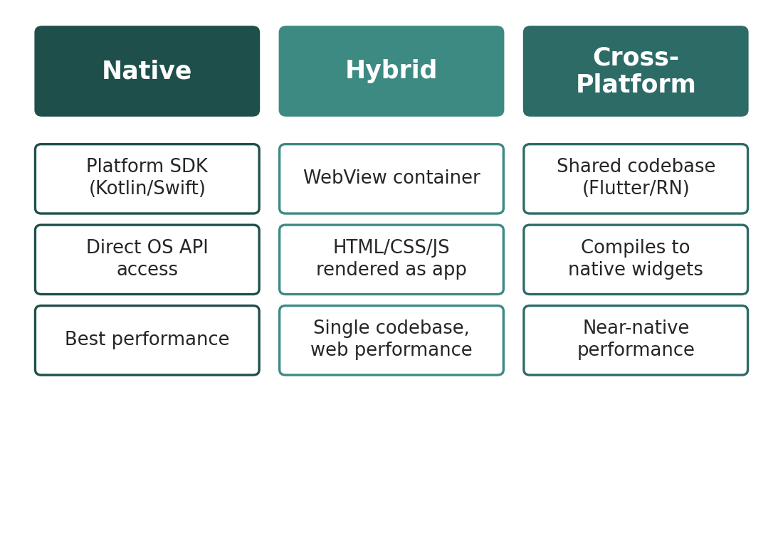
Three Approaches to Building Mobile Apps
[ INSERT IMAGE ]
Native: Built using each platform's own language and SDK (Kotlin/Java for Android, Swift for iOS)
Hybrid: A web app (HTML/CSS/JS) wrapped in a native container and rendered through a WebView
Cross-platform: A single codebase compiled or rendered into native UI components on each platform
Figure 1: Native, hybrid, and cross-platform approaches differ in how code is written and executed on the device

Slide 5
Native Development
Definition
Apps built specifically for one platform using that platform's official language, SDK, and tools
Advantages
Best possible performance; full access to all platform APIs and hardware features on day one
Limitations
Requires separate codebases (and often separate teams) for Android and iOS, increasing cost and time
Typical use case
Apps with demanding performance needs: games, AR/VR, or apps requiring deep hardware integration

Slide 6
Hybrid Development
Definition
A web application (built with standard web technologies) packaged inside a native shell using a WebView
Advantages
Single codebase across platforms; reuses existing web development skills and code
Limitations
Performance and UI feel are constrained by the WebView; limited access to some native features without plugins
Typical use case
Content-driven apps, internal business tools, or MVPs where speed of development matters more than peak performance

Slide 7
Cross-Platform Development
Definition
A single codebase, written in one framework, that compiles to (or renders as) native UI components on each platform
Advantages
Near-native performance and look-and-feel, while sharing most business logic and UI code across platforms
Limitations
Occasional need for platform-specific code for cutting-edge native features; an additional abstraction layer to learn
Typical use case
Most commercial apps today — a strong balance of cost, speed, and quality (e.g., built with Flutter or React Native)

Slide 8
Native Development Tools
Android Studio (for Android)
Xcode (for iOS)
Built on: JetBrains IntelliJ IDEA platform
Languages: Kotlin (preferred) and Java
Includes: Layout editor, emulator, profiler, Gradle build system
Built by: Apple, exclusively for macOS
Languages: Swift (preferred) and Objective-C
Includes: Interface Builder, Simulator, Instruments profiler

Slide 9
Cross-Platform Frameworks: Flutter and React Native
Flutter (Google): Uses the Dart language; renders its own UI widgets directly to the screen rather than using native OS components, giving highly consistent visuals across platforms
React Native (Meta): Uses JavaScript/TypeScript with React; renders using actual native UI components, giving a more platform-authentic feel
Shared principle: Both let developers write most application logic once and deploy to Android and iOS, with optional platform-specific code where needed
We return to these in depth: Week 12 covers hybrid and cross-platform frameworks hands-on, including setting up a real Flutter or React Native project

Slide 10
Comparing the Three Approaches
Table 1: No single approach wins on every dimension — the right choice depends on project priorities
Dimension | Native | Hybrid | Cross-Platform
Performance | Best | Lower | Near-native
Development cost | Highest (2x teams) | Lowest | Moderate
Time-to-market | Slowest | Fastest | Fast
Maintainability | Two codebases | One codebase | One codebase
Access to new OS features | Immediate | Delayed | Often delayed

Slide 11
Reading the Comparison Correctly
No universal winner: Every approach makes a deliberate trade-off between performance, cost, speed, and long-term maintainability
Performance vs. cost tension: Native maximizes performance and platform access at the highest cost; hybrid minimizes cost at some performance expense
Cross-platform as a middle ground: Frameworks like Flutter and React Native increasingly close the performance gap with native, which is why they dominate new app development today
Maintainability compounds over time: A single shared codebase becomes more valuable the longer an app is actively developed and maintained

Slide 12
A Decision Framework for Platform Selection
1. What does the app need to do?
Heavy graphics, AR, or deep hardware access push toward native
2. What is the budget and timeline?
Tight budgets and fast deadlines favor hybrid or cross-platform
3. What skills does the team already have?
Web developers may ship faster with hybrid; JS/React teams may prefer React Native
4. How long will the app be maintained?
Long-lived apps benefit more from a single, maintainable cross-platform codebase
5. Does the app need day-one access to the newest OS features?
If yes, native is safest; cross-platform frameworks sometimes lag behind new OS releases

Slide 13
Worked Example: A Mobile Game Studio
Requirements: High frame-rate 3D graphics, deep access to GPU and sensor APIs
Applying the framework: Performance need is extremely high (favors native); budget allows separate platform teams
Decision: Native development — or a specialized game engine (Unity/Unreal) that compiles natively — is the right choice here

Slide 14
Worked Example: A Startup's MVP
Requirements: Launch on both Android and iOS within 8 weeks, with a 2-person development team and a limited budget
Applying the framework: Time-to-market and cost are the dominant constraints; the app's needs are largely standard UI and API calls, not specialized hardware access
Decision: Cross-platform (Flutter or React Native) is the strongest fit — one codebase, fast iteration, near-native quality

Slide 15
Worked Example: An Internal Company Tool
Requirements: A simple internal app for employees to submit expense reports; performance is not a major concern
Applying the framework: Low performance requirements, small user base, and a team that already builds the company's web portal
Decision: Hybrid development lets the team reuse existing web code and skills, minimizing cost for a low-stakes internal tool

Slide 16
Configuring a Development Environment
Step 1: Choose your platform approach based on the decision framework (this module focuses primarily on native Android with Android Studio)
Step 2: Install the IDE (Android Studio) and accept required SDK licenses
Step 3: Configure an Android Virtual Device (AVD) or connect a physical device with USB debugging enabled
Step 4: Verify the environment by creating a new project from a template

Slide 17
Building Your First App: “Hello World”
Create a new project: Use Android Studio's “Empty Activity” template, which generates a minimal working app
Examine MainActivity: This file contains the onCreate() method where the app's first screen is set up
Examine activity_main.xml: This layout file defines the UI — by default, a single TextView displaying “Hello World!”
Run the app: Build and deploy to the emulator or a connected device to see the running app for the first time
What this demonstrates: Even a minimal app already uses the Activity lifecycle, layout system, and build process introduced in previous weeks

Slide 18
Key Takeaways
Native, hybrid, and cross-platform are three distinct approaches with different performance, cost, and maintainability trade-offs
Native development (Android Studio, Xcode) offers the best performance and platform access but the highest cost
Cross-platform frameworks like Flutter and React Native offer a strong balance and now dominate new app development
Platform selection should follow a deliberate decision framework based on requirements, budget, timeline, and team skills
A working development environment and a successfully built “Hello World” app are the practical foundation for everything that follows

Slide 19
Summary
This week answered a foundational practical question: how should a team actually build a mobile app? We examined native, hybrid, and cross-platform approaches, comparing their performance, cost, time-to-market, and maintainability trade-offs.
We applied a decision framework to real-world scenarios — a game studio, a startup MVP, and an internal tool — each landing on a different, well-justified platform choice.
With a working development environment and a first running app in place, next week we move from platform choice to internal application architecture.

Slide 20
Discussion Questions
If you were building a banking app, which approach would you choose and why? Which decision-framework factors matter most for this case?
Why do you think cross-platform frameworks have grown so much in popularity over the last decade, relative to native and hybrid approaches?
Can you think of a scenario where starting with hybrid development and later migrating to native (or cross-platform) might make sense as a business strategy?
What risks does a team take on by choosing a cross-platform framework, given that new OS features sometimes arrive on native platforms first?

Slide 21
Thank You !
Questions?
Email: Sammani@kln.ac.lk | Department of Industrial Management

